Slide 1

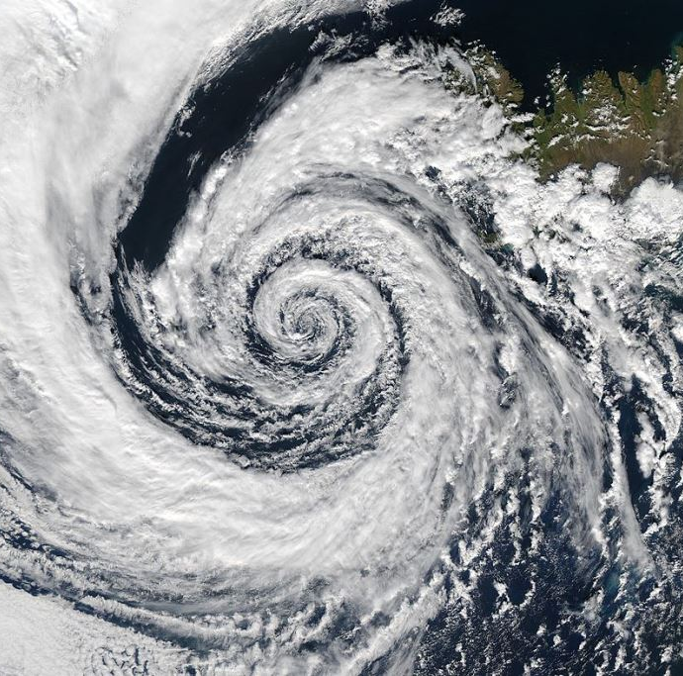
DEEP LEARNING IN CYCLONE FORECASTING
Manish Kumar Mawatwal
MS2104121004
DAASE, IIT Indore
MS (Research) in SSE
Supervisor : Dr Saurabh Das
PSPC : Dr Amit Shukla, Dr Somnath Dey, Dr Suman Majumdar

Slide 2
Thesis Outline
Motivation
Objectives
Existing Techniques
Need for Image Analysis
Key Advantages of Using Deep Learning
Research Work 1
Research Work 2
Research Work 3
Research Work 4
Future Scope
Publication Details
Acknowledgments
References

Slide 3
Motivation
Bangladesh
Most affected by TC
1,408
Billion in economic losses
8 lac
People killed
1,942
disasters
43
Deaths every day
78
Million damages every day
3

Slide 4
Objectives
Objectives
Multiclass Cyclone Classification
Cyclone Detection
Binary Cyclone Classification
Regression
Rapid Intensification Detection
Quick Response and evacuation from NDMA, GoI
Prevent socio-economic loss
Reroute ships and fishermen in open oceans
Understanding cyclogenesis
Stop false alarms
Early warning messages
4

Slide 5
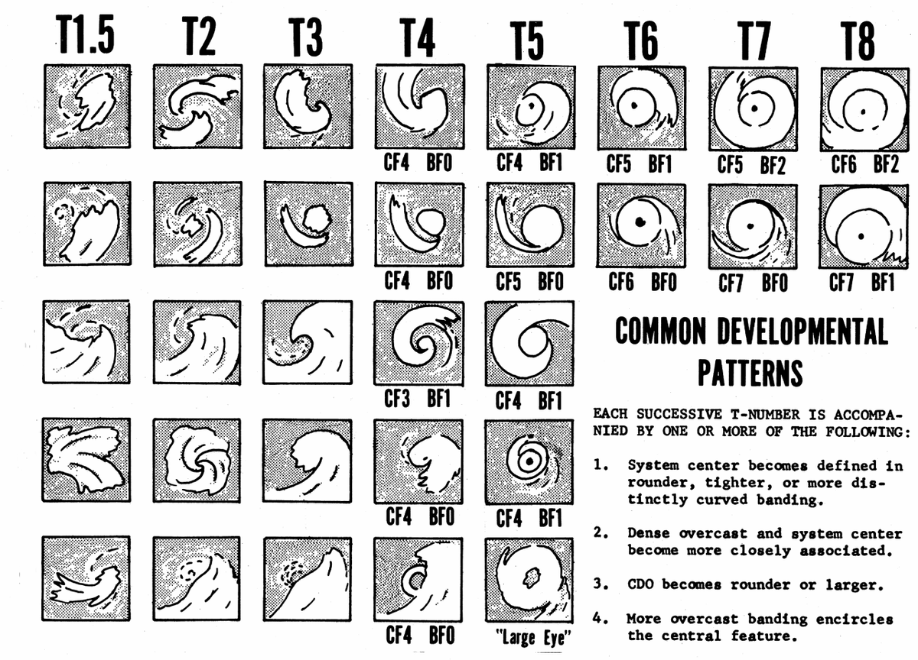
EXISTING TECHNIQUES
Technique | Limitation
Dvorak Technique | Human intervention leads to differences in assigning T-number.
Advanced Dvorak Technique | Performance is bad during smaller cyclones or disordered cloud.
Deviation Angle | Models and parameters are different for different locations.
Passive Microwave Imagery-Based Tropical Cyclone Intensity Estimation. | Intensity estimation depends on frequency of observations.
Convolutional Neural Network | Requires a large amount of dataset
Research Gaps
Cyclones cross oceans, information transfer between storms from different basins is difficult
Complex and nonlinear relationships between TC parameters
Inaccurate vortex initialization, incomplete knowledge of complex physical processes
5

Slide 6
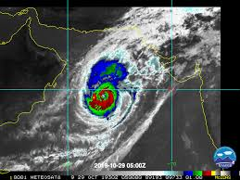
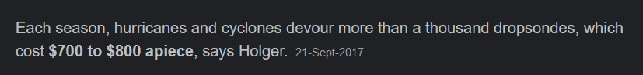
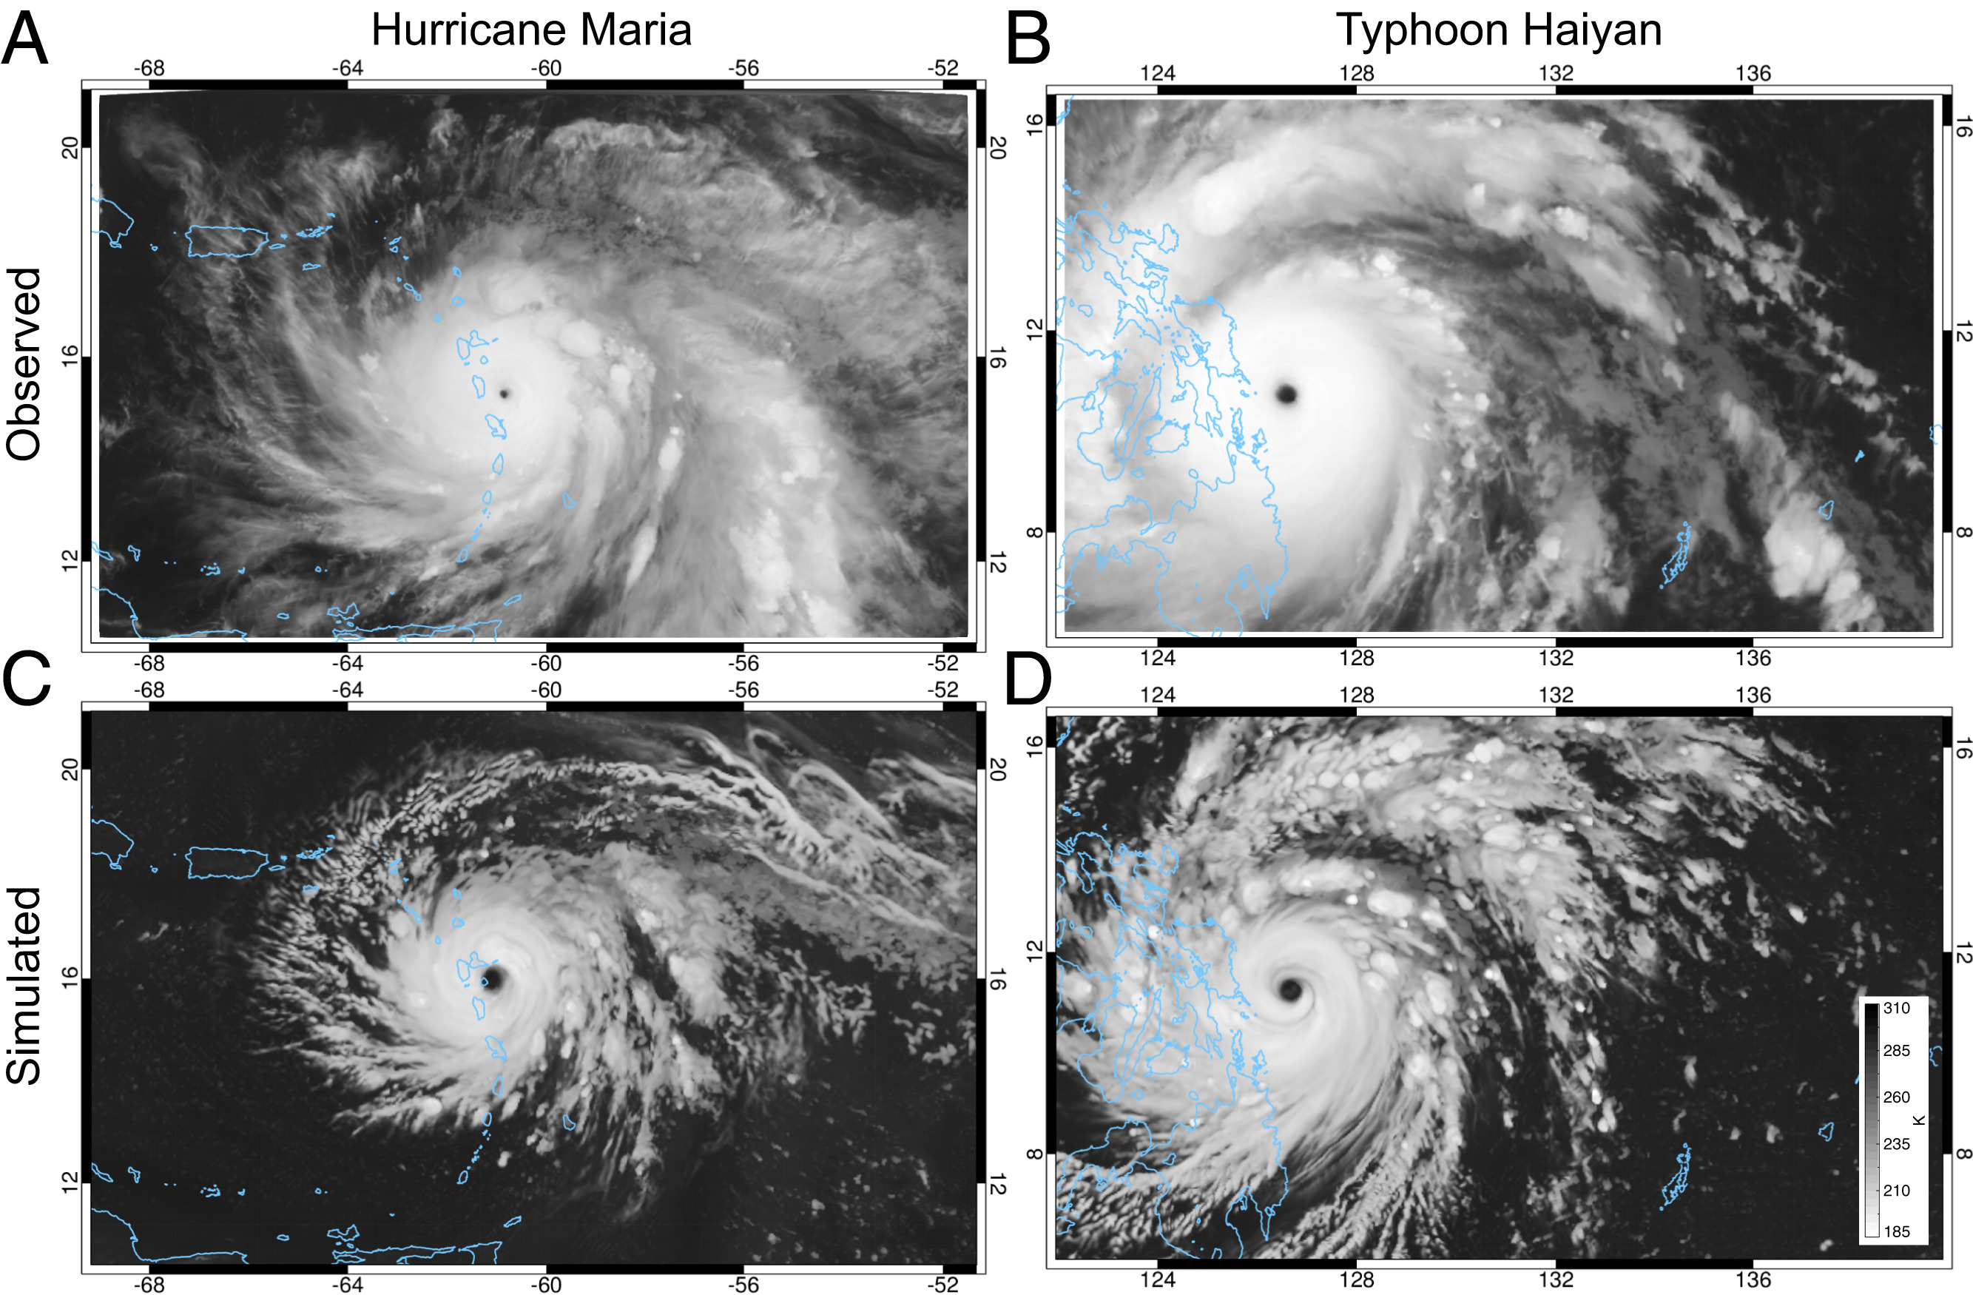
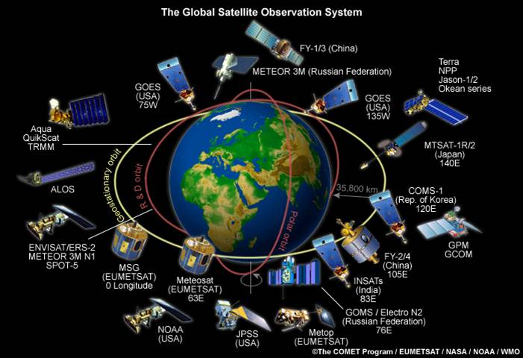
Need for image analysis
Reasons
Costly devices
Huge number of Global Satellite system
In-situ availability of cyclone images.
Image Sources:
Global Weather and Climate Center (Top left)
Image Courtesy: http://www.fe-lexikon.info/ (Bottom left), https://doi.org/10.1073/pnas.2013584117 (Bottom right)
6

Slide 7





Key Advantages of using Deep Learning
Reduced computation time
GPUs helps in faster execution of complex processes
DL is successful in CV, image recognition, object detection etc
Direction of rotation, shape of eye, pattern etc; extracted via CNN
Air-sea interaction process are highly non-linear, hence non-linear methods
7

Slide 8
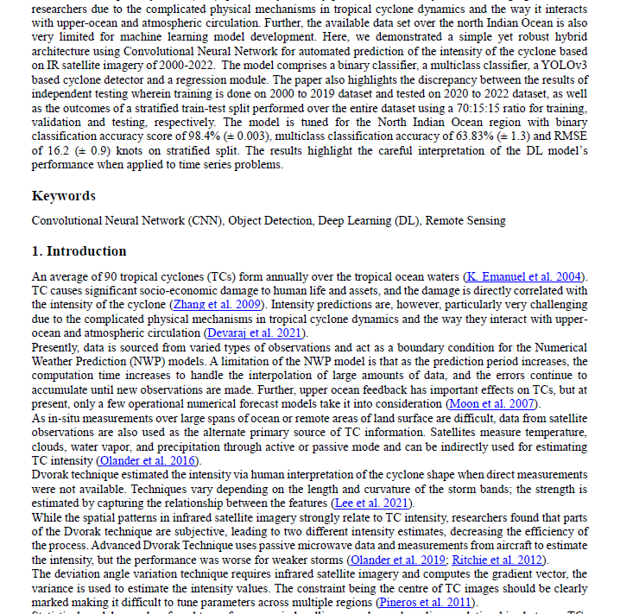
Part 1
An End-to-End Deep Learning Framework for Cyclone Intensity Estimation in North Indian Ocean Region Using Satellite Imagery
8

Slide 9
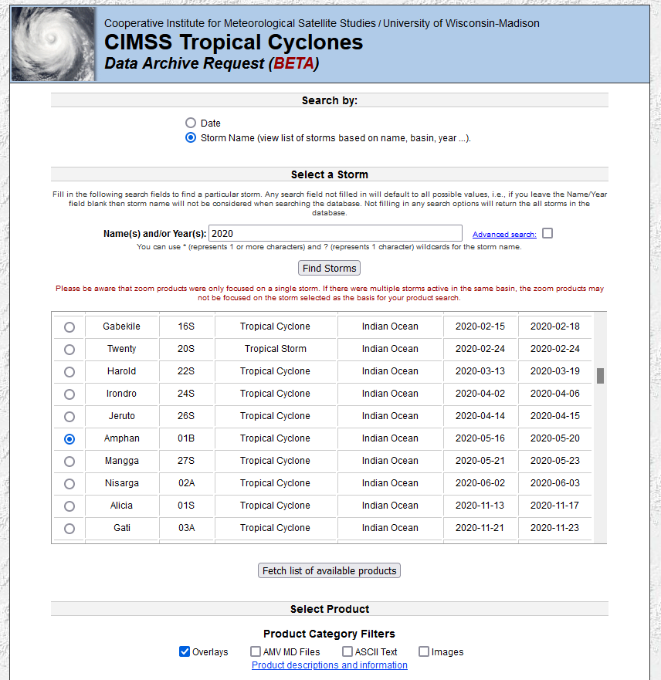
Dataset (1/4)
Source
Infrared images taken from CIMSS Tropical Data Archive (Satellite: Meteosat 5/7/8)
Features
Doesn’t have centre cyclone, data augmentation improves performance
Characteristics
Temporal resolution is 3hr/6hr
Images are in Grayscale and cropped with non cyclonic parts.
Best Track Cyclone data is taken from IMD website for labelling the intensity.
Image is cropped to a resolution of 310x310 keeping cyclone within 3X3 grid.
Cropped region : 40E to 100E, 10S to 20N
Focused area: Bay of Bengal and Arabian Sea
Each image contains the name of the satellite, type of image, time and date
Non cyclonic image data is taken from January 2019, 2020 and 2021
Fig: CIMSS Tropical Cyclones Website
9

Slide 10
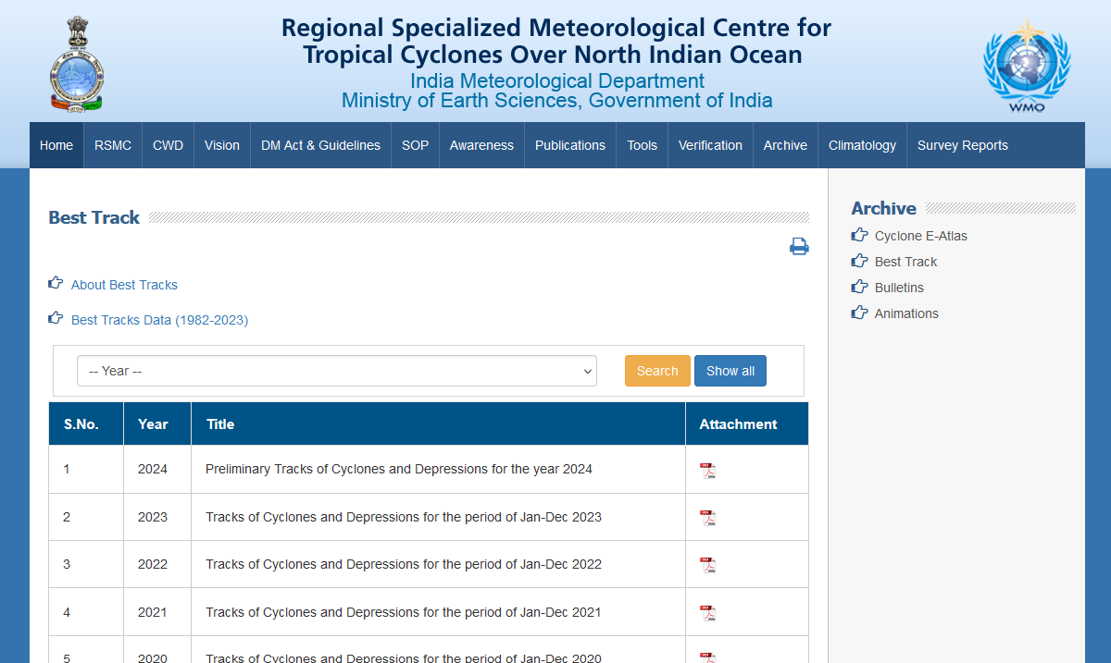
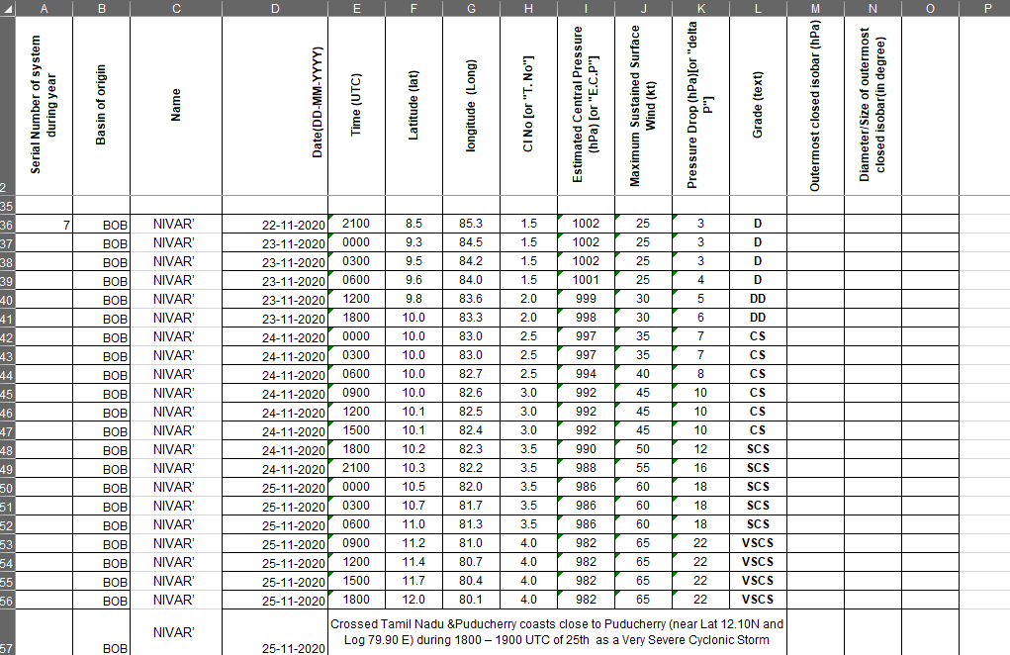
Dataset (2/4)
Fig: RSMC New Delhi Website
Fig: Best Track Cyclone Dataset
Problems in Data Collection
Missing information of some of the cyclones in Best Track RSMC New Delhi data hence the images from these cyclones cannot be annotated with MSW speeds.
MSW data of cyclones after it crosses the coast/landfalls is not available in most cases which might lead to inaccuracies in annotating the images/classifying the images into different classes.
For some temporal resolution(3hr/6hr) the best track data is not available.
Missing data in images which creates problem in training NN and hence are removed from the dataset. The data has to be cleaned before fitting on model.
10

Slide 11
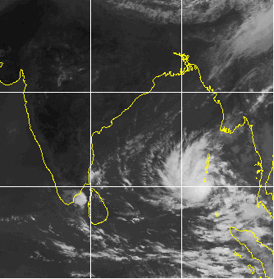
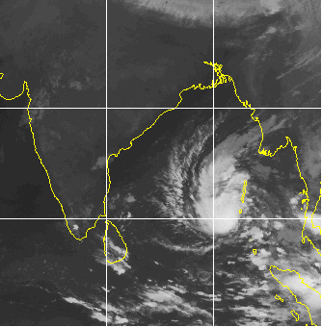
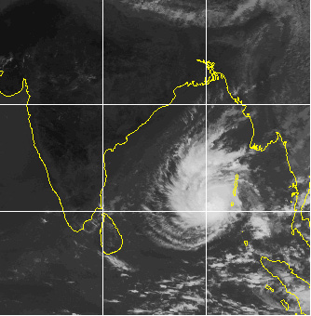
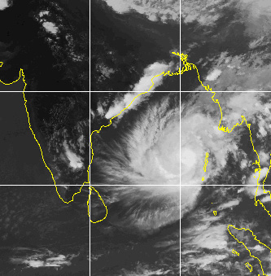

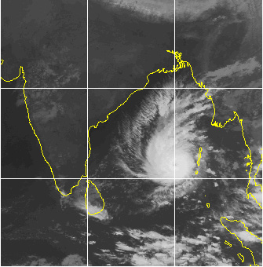
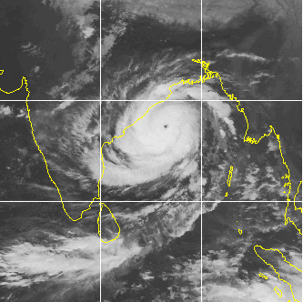
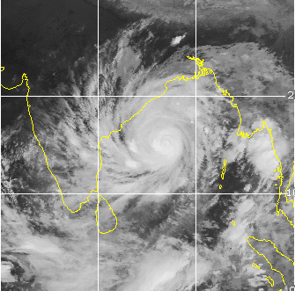
Dataset(3/4)
Depression (20-25 knots)
Deep Depression (30-35 knots)
Cyclonic Storm (40-50 knots)
Severe Cyclonic Storm (55-65 knots)
Very Severe Cyclonic Storm (70-90 knots)
Extremely Severe Cyclonic Storm (95-120 knots)
Super Cyclonic Storm (125+ knots)
11

Slide 12
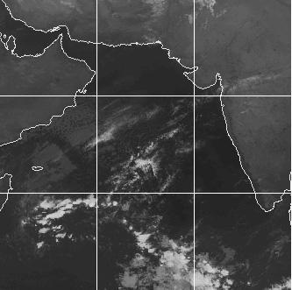
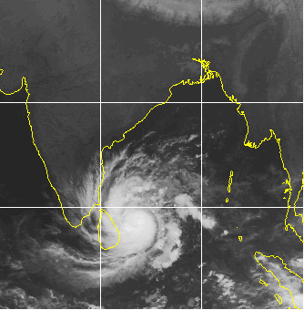
Dataset(4/4)
Table: Data Split
 | Binary Classification | Multiclass Classification | Regression
Training | 1154 | 1316 | 1308
Validation | 247 | 280 | 348
Testing | 249 | 288 | 281
Total | 1650 | 1884 | 1869
Fig: No cyclone
Table: Category of cyclones (Multiclass classification)
Category | Wind Speed | Actual Images
Depression (D) | 20-25 knots | 352
Deep Depression (DD) | 30-35 knots | 534
Cyclonic Storm (CS) | 40-50 knots | 396
Severe Cyclonic Storm (SevereCS) | 55-65 knots | 257
Very Severe Cyclonic Storm (VSCS) | 70+ knots | 305
Fig: Cyclone
12

Slide 13
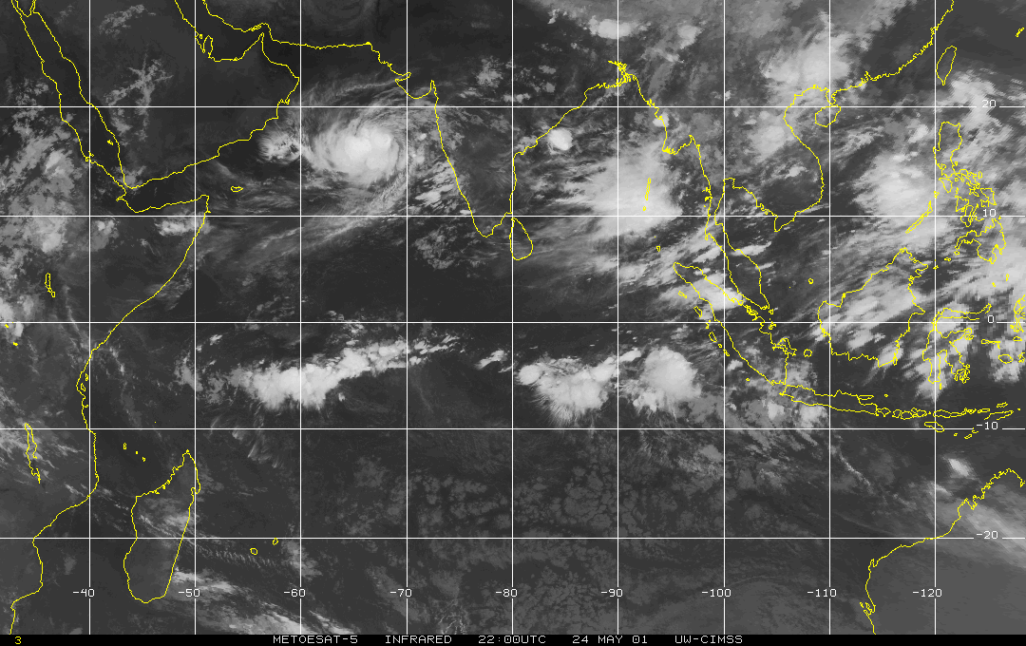
Cyclone
Latitude
Arabian Sea
Bay of Bengal
Longitude
Fig: Raw image file from CIMSS data archive
13

Slide 14
Cyclone Dataset Table
Year | Cyclone Number
2000 | 04B
2001 | 01A
2003 | 01B, 03B
2004 | 01A, 05A (Agni), 01B
2005 | 06B (Fanoos), 05B (Baaz)
2006 | 02B (Mala)
2007 | 02A (Gonu), 06B (Sidr)
2008 | 01B (Nargis), 04B (Rashmi), 05B (Khai-Muk), 06B (Nisha)
2009 | 01B (Bijli), 02B (Aila), 05B (Ward)
2010 | 01B (Laila), 02A (Bandu), 03A (Phet), 04B (Giri), 05B (Jal)
2011 | 03A (Keila), 06B (Thane)
Year | Cyclone Number
2012 | 02B (Nilam), 01A (Murjan)
2013 | 01B (Mahasen), 02B (Phailin), 04B (Helen), 05B (Lehar), 06B (Madi)
2014 | 01B, 02A, 03B (Hudhud), 04A (Nilofar), 05B
2015 | 01A (Ashobaa), 02B (Komen), 03A, 04A (Chapala), 05A (Megh)
2016 | 01B (Roanu), 02A, 03B (Kyant), 04B (Nada), 05B (Vardah)
2017 | 01B (Maarutha), 02B (Mora), 03B (Ockhi), 04B
2018 | 01A (Sagar), 02A (Mekunu), 04B (Daye), 05A (Luban), 06B (Titli), 07B (Gaja), 08B (Phethai)
2019 | 01B (Fani), 02A (Vayu), 03A (Hikaa), 04A (Kyaar), 05A (Maha), 06A (Pawan), 07A
2020 | 01B (Amphan), 02A (Nisarga), 03A (Gati), 04B (Nivar), 05B (Burevi)
2021 | 01A (Tauktae), 02B (Yaas), 03B (Gulab), 03A (Shaheen)
2022 | 01B, 02B(Asani)
14

Slide 15
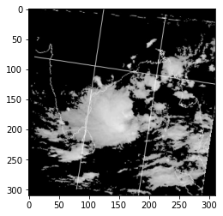
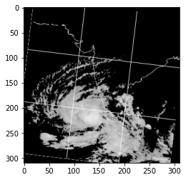
Image Processing and Tuning
Table: Hyperparameter optimised for proposed model
 | Binary Classifier | Multiclass classifier | Regression
Epochs | 30 | 50 | 40
Optimiser | Adam | Adam | Adam
Loss function | Binary Cross-entropy | Categorical Cross-entropy | Mean Squared Error (MSE)
Initial Learning rate | 0.0001 | 0.0001 | 0.001
Batch size(Training, Validation, Testing) | 2, 1, 1 (70:15:15) | 2, 1, 1 | 2, 1, 1
Fig: Pre-processed image (thresholding at 126 pixel value)
15

Slide 16
Data Processing and Modelling
Data augmentation
Over-fitting problem mitigation
Increase dataset size
Data augmentation
Dropouts
Early stopping
Regularization
Pre-trained models
Class Imbalance problem
Ensemble methods
Class weights
rotation_range = 10
fill_mode = ‘constant’
cval = 0
Dropout value = 0.4
monitor = ‘val_accuracy’
16

Slide 17
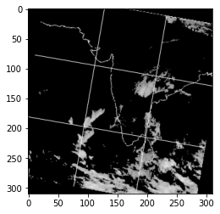
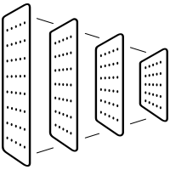
Proposed CNN Model
Layer | Filters/Dropout value/Units | Kernel size/ Pool size | Activation
Convolution | 32 | 3,3 | ReLU
Max Pooling |  | 2,2
Dropout | 0.4
Convolution | 64 | 3,3 | ReLU
Max Pooling |  | 2,2
Dropout | 0.4
Convolution | 128 | 3,3 | ReLU
Max Pooling |  | 2,2
Dropout | 0.4
Convolution | 128 | 3,3 | ReLU
Max Pooling |  | 2,2
Dropout | 0.4
Flatten
Dropout | 0.4
Dense | 512 |  | ReLU
Dropout | 0.4
Dense | 5 |  | SoftMax
Category : Depression
MSW : 24 knots
CNN Architecture
Input image
Output result
Fig: Pictorial representation (general workflow)
Used a custom network architecture that outputs an actual class and wind speed estimate.
4 convolutional layers.
2 dense layers
Model was built using TensorFlow

Slide 18
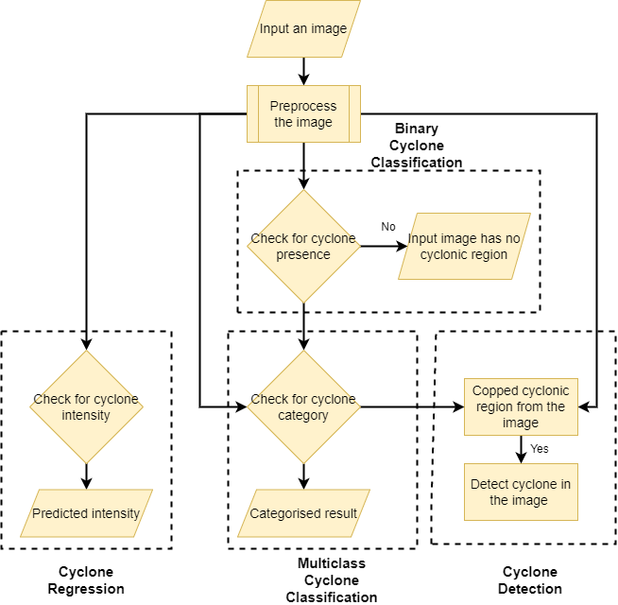
Summarised Workflow
Fig: Flowchart of the implemented pipeline.
18

Slide 19
Results
Table: Comparison of different models
Model | Multiclass Classification Accuracy | Binary Classification Accuracy | Regression RMSE
Proposed Model | 63.83 ± 1.3 [31.2 ± 0.78] | 98.4 ± 0.003 | 16.2 ± 0.9 [26.69 ± 0.88]
VGG-16 Model | 39.83 ± 0.86 [30.3 ± 1.04] | 96.7 ± 0.007 | 19.79 ± 0.21 [20.67 ± 0.03]
Inceptionv3 Model | 51.51 ± 1.29 [36.1 ±5.65] | 97.5 ± 0.01 | 12.4 ± 0.29 [17.28 ± 0.53]
XceptionNet | 40.19 ± 1.07 [30.9 ± 1.78] | 97.9 ± 0.0024 | 22.52 ± 0.8 [21.32 ± 1.43]
ResNet50 | 28.81 ± 0.005 [28.4 ± 0] | 98.3 ± 0.0015 | 13.88 ± 0.28 [22.35 ± 0.47]
Table: Evaluation metrics for multiclass classification
Fig: Cyclone-wise metrics
Category | Precision | Recall | F1-score
D (20-25) | 0.70 | 0.64 | 0.67
DD(30-35) | 0.62 | 0.72 | 0.67
CS(40-50) | 0.54 | 0.55 | 0.54
SevereCS(55-65) | 0.59 | 0.59 | 0.59
VSCS (70+) | 0.76 | 0.60 | 0.67
Category | Accuracy (%) | False Positive Rate (%)
D | 66.5 ± 2.17 | 6.77 ± 0.86
DD | 70.54 ± 2.06 | 15.25 ± 0.82
CS | 52.34 ± 0.96 | 9.63 ± 1.34
SevereCS | 58.51 ± 1.57 | 5.22 ± 0.64
VSCS | 71.37 ± 2.13 | 5.45 ± 0.63
19

Slide 20
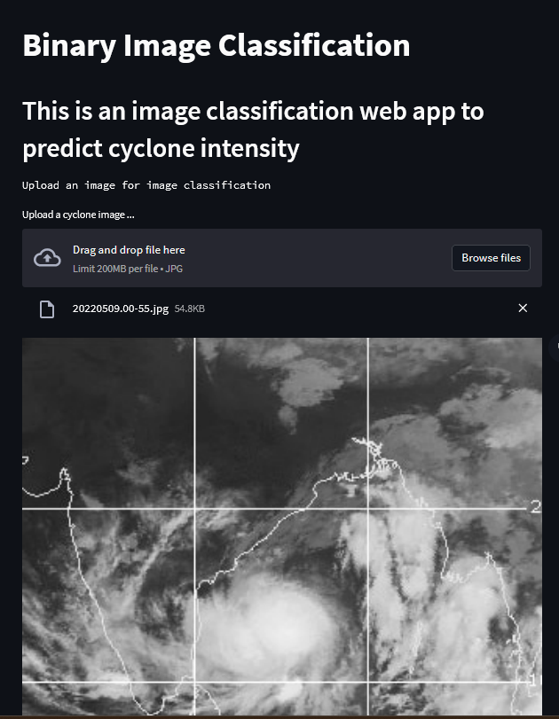
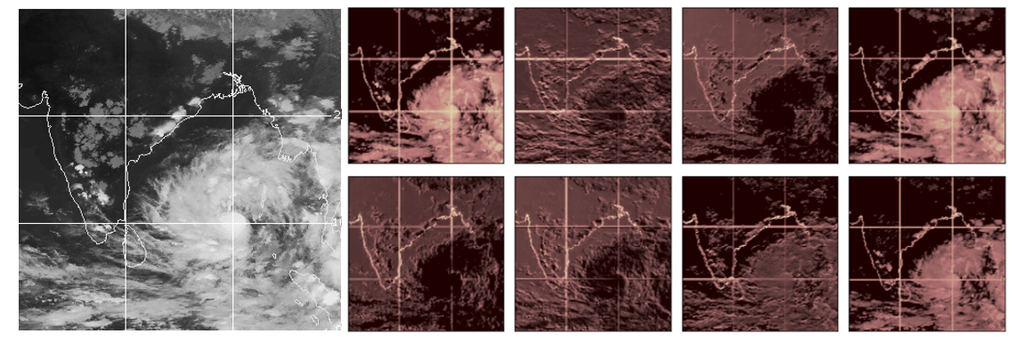
Deployment of Model & Feature Maps
Fig: Feature Maps from the first layer of CNN
Streamlit is an open source app framework in Python language. It helps us create web apps.
In heatmaps generated by CNNs, brighter areas typically indicate regions of the input image that have higher activation values in the corresponding feature maps.
Fig: Web Deployment Using Streamlit
20

Slide 21
Result Comparison
Paper | Dataset | Result | Limitation
Snehlata Shakya et al, “Deep Learning Algorithm for Satellite Imaging Based Cyclone Detection”, IEEE Journal 2020 | 995 images of cyclone from IMD | 97% accuracy on Binary Classification 84% confidence on Cyclone Detection (YOLO) 58% accuracy on Multiclass Classification | Less dataset, heavy pre-processing, Considered only three categories of cyclone (SevereCS, CS, SuperCS)
Aravind Nair et al, “A Deep Learning Framework for the Detection of Tropical Cyclones From Satellite Images”, IEEE Journal 2022 | 816 images of cyclone from EUMETSAT | 86.55% accuracy on Cyclone Detection (Mask R-CNN) Binary Classification: Recall score 76.14% | Less dataset
Shweta Kumawat et al, “Cyclone Detection and Forecasting Using Deep Neural Networks Through Satellite Data”, Springer Conference 2021 | 931 images of cyclone from IMD (Visual and Infrared) | 96% accuracy on Binary Classification 85% confidence on Cyclone Detection (YOLO) | Less dataset
Chinmoy Kar et al, “Tropical cyclone intensity detection by geometric features of cyclone images and multilayer perceptron”, Springer Journal 2019 | 379 images of cyclone from IMD | 84% accuracy on 3 classes of cyclone | Less dataset, Considered only three categories of cyclone (D, CS, ESCS)
Proposed Model | 1884 (additional 708 images for ‘no’ category) images from CIMSS, Best Track data from IMD | 98.4% accuracy score on Binary classification, 63.83% on multiclass classification (five categories), 16.2 knots on regression and YOLO cyclone detection. | Manual cropping, imbalanced dataset
21

Slide 22
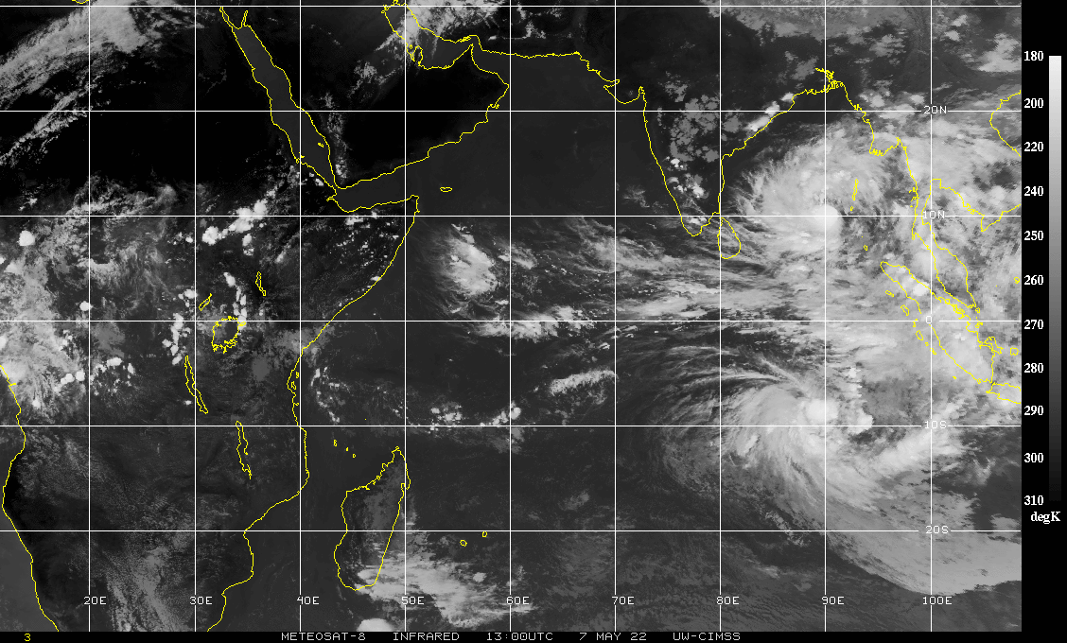
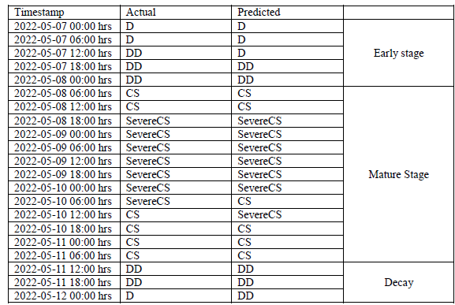
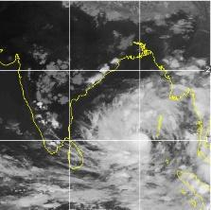
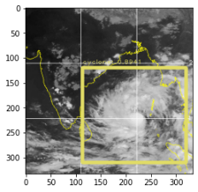
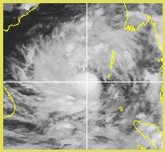
Case study: ‘Asani’ (2022) cyclone
Table: “Asani” Cyclone Stage Detections
(a)
(b)
(c)
(d)
Fig: (a) shows original image (2022-05-07, 12:00 hrs), (b) shows the pre-processed image, (c) shows the detected cyclone and (d) shows the enlarged view of the detected cyclone.
22

Slide 23
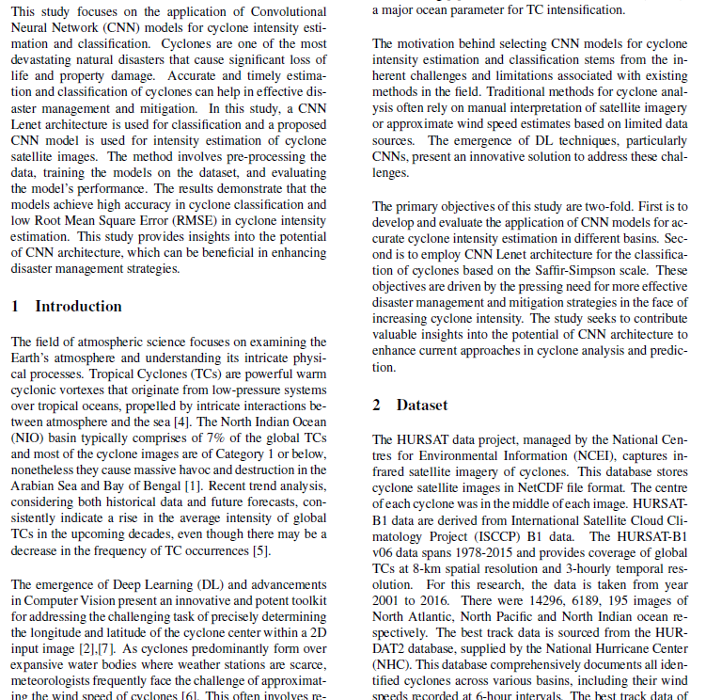
Part 2
Deep Learning Regression and Classification of Tropical Cyclones based on HURSAT data
23

Slide 24
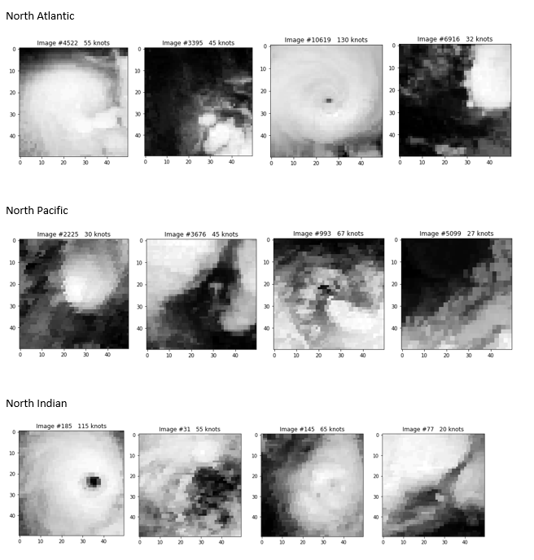
Data Processing and Hyperparameter Tuning
Dataset: HURSAT data from International Satellite Cloud Climatology Project (ISCCP). Best Track data from HURDAT2 database.
Basin | Number of images | Year
North Atlantic | 14296 | 2001 to 2016
North Pacific | 6189 | 2001 to 2016
North Indian | 195 | 2001 to 2016
Table: Hyperparameter Tuning
Optimizer | rmsprop
Loss | MSE
Metrics | Root Mean Squared Error
Convolutional layers | 4
Epochs | 100
Batch size | 64
K-folds | 5
Fig: HURSAT Dataset
24

Slide 25
HURSAT Results (1/2)
Table: Regression Testing Results
Basin | Mean Absolute Error | Root Mean Square Error | K-folds
North Atlantic | 9.7 knots | 12.38 knots | 5
North Pacific | 14.75 knots | 18.66 knots | 5
North Indian | 12.93 knots | 16.22 knots | 5
North Atlantic and North Pacific combined | 11.58 knots | 14.74 knots | 5
North Indian, North Atlantic and North Pacific combined | 11.77 knots | 14.8 knots | 5
Table: Classification Results
Training | Testing | Classes | Validation Accuracy
North Atlantic images | North Indian images | 5 | 63.14%
North Pacific images | North Indian images | 5 | 52.6%
North Atlantic images | North Indian images | 7 | 57.8%
North Pacific images | North Indian images | 7 | 33.2%
North Atlantic and North Pacific images | North Indian images | 5 | 55.1%
North Atlantic and North Pacific images | North Indian images | 7 | 53.6%
25

Slide 26
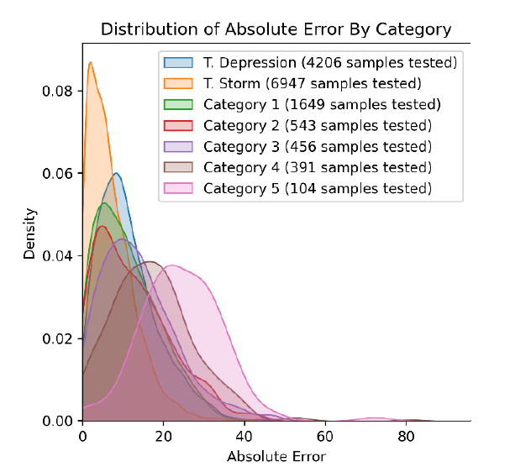
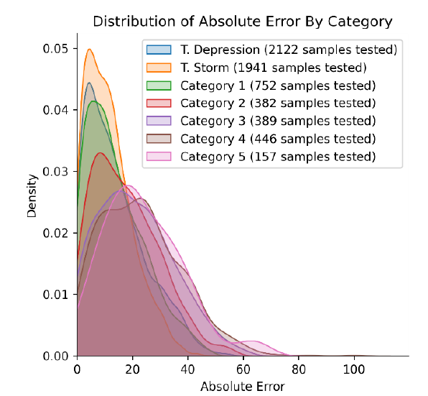
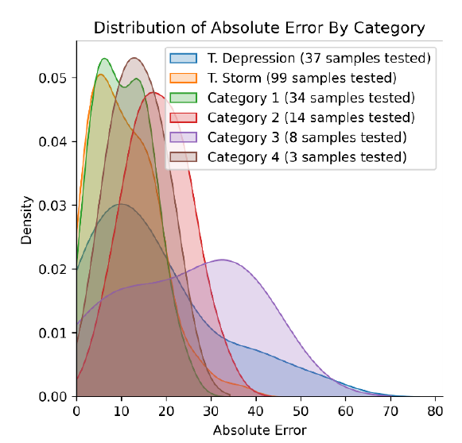
HURSAT Results (2/2)
Fig: North Atlantic Ocean Absolute Error Distribution
Fig: North Pacific Ocean Absolute Error Distribution
Fig: North Indian Ocean Absolute Error Distribution
26

Slide 27
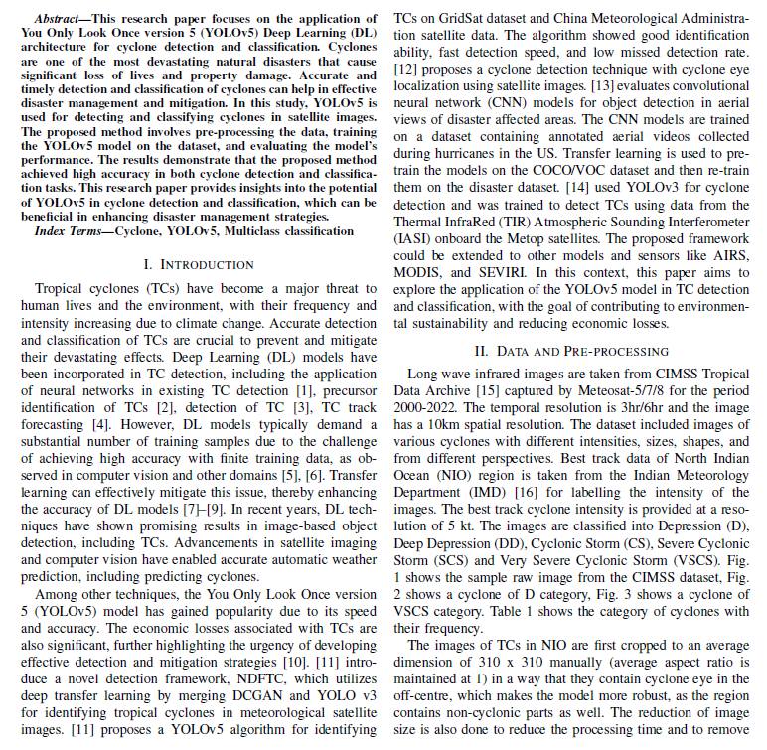
Part 3
North Indian Ocean Tropical Cyclone Detection Using YOLOv5
27

Slide 28
Data & Methodology using YOLOv3 Architecture
Images from CIMSS Tropical Data Archive captured Meteosat-5/7/8 for the period of 2000-2022.
Best Track data of NIO region is taken from the IMD for labelling the intensities of the images.
Hyperparameter Tuning
Resized image: 640x640
Confidence threshold for object detection: 0.25
IoU threshold: 0.45
Batch size: 2
Version of YOLOv5: YOLOv5x
Table: Category of cyclones (multiclass classification)
Category | Wind Speed | Actual number of images
D | 20-25 knots | 352
DD | 30-35 knots | 534
CS | 40-50 knots | 396
SCS | 55-65 knots | 257
VSCS | 70+ knots | 305
Source: Detection of Collapsed Buildings in Post-Earthquake Remote Sensing Images Based on the Improved YOLOv3 - Scientific Figure on ResearchGate. Available from: https://www.researchgate.net/figure/Structure-of-the-Darknet53-convolutional-network_fig4_338121987
28

Slide 29
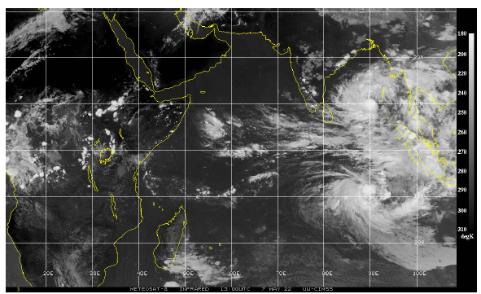
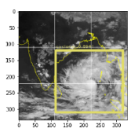
Cyclone Detections using YOLOv5 (1/2)
Fig: Shows the pre-processed image.
Fig: Shows the detected cyclone
Fig: Original image (2022-05-07, 12:00:00 hrs)
Fig: Shows the enlarged view of the detected cyclone ”Asani”
29

Slide 30
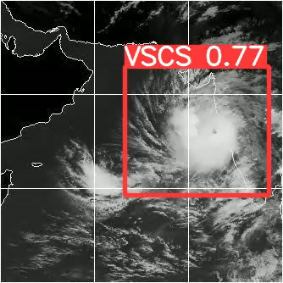
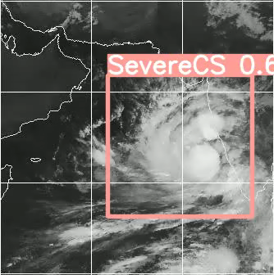
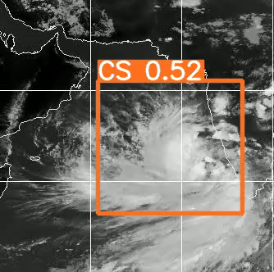
Cyclone Detections using YOLOv5 (2/2)
* video gifs
30

Slide 31
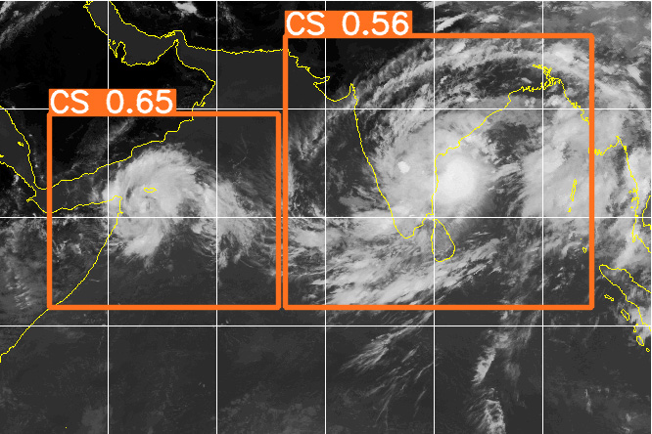
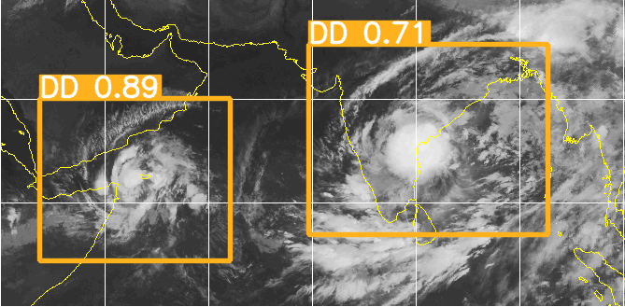
Multiple Cyclone Detections using YOLOv5
Detection of cyclones using YOLOv5 | Precision: 60% Recall: 96.9% mAP: 0.77 Accuracy over 2022 dataset: 89%
Fig: Multiple cyclone detections
31

Slide 32
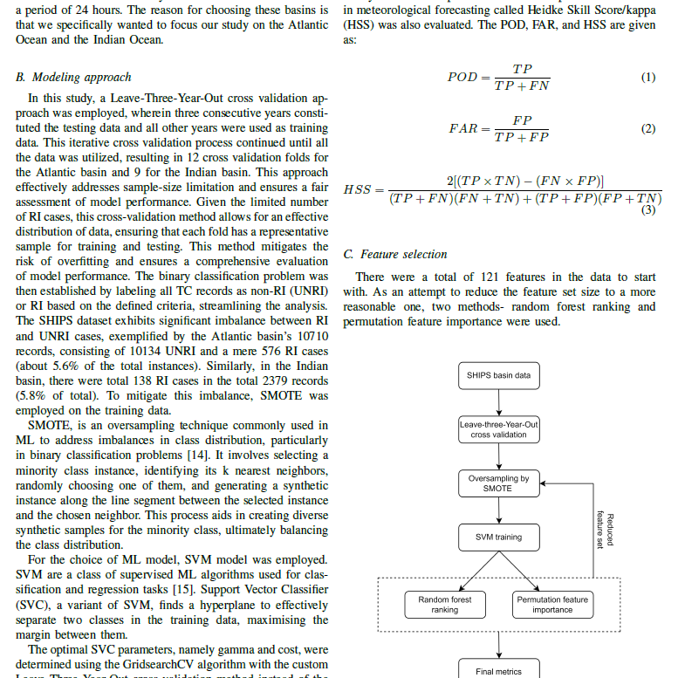
Part 4
A Machine Learning Approach for Detecting Rapid
Intensification in Tropical Cyclones
32

Slide 33
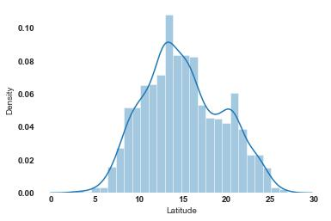
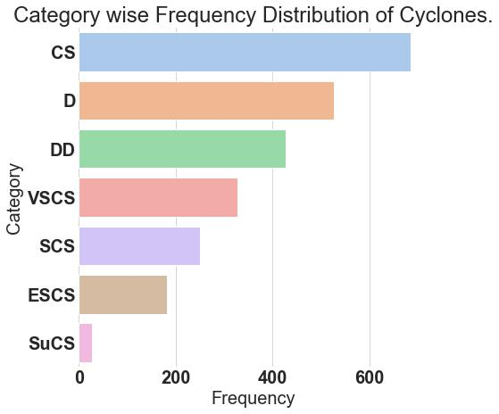
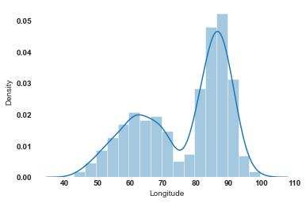
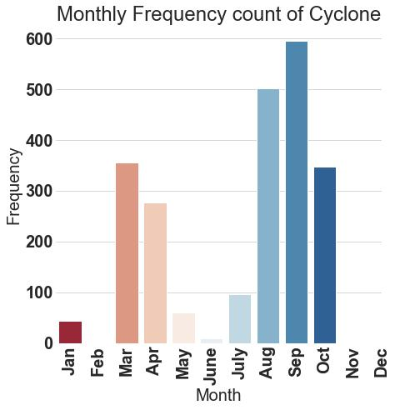

Cyclone General Analysis
Fig: Probability Density vs Latitude
Fig: Probability Density vs Longitude
*Across the years
Fig: Probability Density vs Maximum Wind Speed
33

Slide 34
Introduction & Dataset
Occurs when MSW increases by at least 35mph (miles per hour) in a 24hr period.
Rapid Intensification (RI) classification that utilizes Support Vector Machines (SVM) in conjunction with the SMOTE oversampling technique to handle class imbalance. The proposed approach has the potential to be a useful tool for forecasters to issue timely warnings and prepare for the impacts of RI events.
Dataset – SHIPS (publicly available on RAMMB website)
Years – 1982 to 2017
Basins – Atlantic, Indian, Western North Pacific, Eastern North Pacific
Methodology followed – LOYO
Binary Classification problem
Class imbalance mitigation – SMOTE (Synthetic Minority Oversampling Technique) oversampling
Feature Selection – Random forest algorithm
k_neighbors = 10
34

Slide 35

Rapid Intensification Methodology
Random forest ranking
Atlantic: 22 features
Indian: 10 features
Western North Pacific: 13 features
Eastern North Pacific: 36
121 features
SVM Classification
Figure: Comparison of the Atlantic basin in terms of Probability of Detection and False Alarm Rate of RI events
35

Slide 36
Rapid Intensification Results
Table: RI detection results for Atlantic and Indian basins in terms of the 95% confidence intervals of the metrics. The model was run 20 times for the evaluation and the number of features retained has been varied from 20, 40, 60, and all the 121 features.
36

Slide 37
Conclusion & Future Scope
A deep learning framework has been developed to estimate and classify TC from Meteosat satellite images over NIO regions for the period 2000-2022. The performance of the architecture is found to be better or comparable with other existing studies in both the evaluation method.
Exploring GAN for imbalanced dataset optimisation, regression analysis, damage prediction by cyclones, disaster prediction etc.
Using images from different channels (Infrared channel, Visible channel, Water Vapour) to create a 3D-CNN model and verify whether the classifier accuracy is improved in predicting the correct category of the cyclone.
37

Slide 38
Publication Details
Journal
Manish Mawatwal, Saurabh Das, “An End-to-End Deep Learning Framework for Cyclone Intensity Estimation in North Indian Ocean Region using Satellite Imagery”, Journal of Indian Society of Remote Sensing, 2024 (Accepted).
Tushar Sharma, Manish Mawatwal, Saurabh Das, “An Explainable Machine Learning Approach for Predicting Rapid Intensification in Tropical Cyclones” (Under Review)
Conference
Manish Mawatwal, Saurabh Das, “North Indian Ocean Tropical Cyclone Intensity Prediction using Machine Learning Classifiers and Analysis”, Regional Conference on Radio Science, Indore, 2022 (published as Extended Abstract).
Manish Mawatwal, Saurabh Das, “Deep Learning Regression and Classification of Tropical Cyclones based on HURSAT data,” URSI AT-RASC 2024, Spain (presented and to be published in IEEE Xplore).
Manish Mawatwal, Saurabh Das, “North Indian Ocean Tropical Cyclone Detection Using YOLOv5,” WCONF 2024, Raipur (Accepted, to be presented and publish in IEEE Xplore).
38

Slide 39
Acknowledgements
Thankful to IIT Indore for providing me the opportunity to pursue MS by Research Degree.
Sincere gratitude to my guide Dr. Saurabh Das, my lab mates - Nitig Singh, Lekhraj Saini, Vaibhav Tyagi, Hemapriya R, Pushp Ranjan, Soumen Datta.
Thankful to the Chairman OEB, External supervisor and PSPC Members for their valuable suggestions.
Heartful thanks to all the staff at IIT Indore for their help in carrying out research work.
39

Slide 40
References
[1] Devaraj J, Ganesan S, Elavarasan RM and Subramaniam U, “A Novel Deep Learning Based Model for Tropical Intensity Estimation and Post-Disaster Management of Hurricanes”, Applied Sciences, 2021, 11, 4129.
[2] Moon, I.J.; Ginis, I.; Hara, T.; Thomas, B., “A Physics-Based Parameterization of Air-Sea Momentum Flux at High Wind Speeds and Its Impact on Hurricane Intensity Predictions”, Mon. Weather Rev. 2007, 135, 2869–2878.
[3] Timothy L. Olander and Christopher S. Velden, “The current status of the UW-CIMSS Advanced Dvorak Technique (ADT)”, Conf. on Hurricanes and Tropical Meteorology, Apr. 2016.
[4] Yu-Ju Lee, “Interpretable tropical cyclone intensity estimation using Dvorak-inspired machine learning techniques”, Engineering Applications of Artificial Intelligence, vol. 101, May 2021.
[5] T.L. Olander and C.S. Velden, “The advanced Dvorak technique (ADT) for estimating tropical cyclone intensity: Update and new capabilities”, Weather Forecasting, vol. 34, no. 4, pp. 905-922, 2019.
[6] M. F. Pineros, E.A. Ritchie, and J.S. Tyo, “Estimating tropical cyclone intensity from infrared image data”, Weather Forecasting, vol 26, no. 5, pp. 690-698, Oct 2011.
[7] E.A. Ritchie and K.G. Valliere, “Tropical cyclone intensity estimation in the North Atlantic basin using an improved deviation angle variance technique”, Weather Forecasting, vol. 27, no. 5, pp. 1264-1277, Oct 2012.
[8] Lee, C.Y.; Tippett, M.K.; Camargo, S.J.; Sobel, A.H. “Probabilistic Multiple Linear Regression Modeling for Tropical Cyclone Intensity” Mon. Wea. Rev. 2015, 143, 933–954.
[9] N. Sharma, M.M. Ali, John A. Knaff and P. Chand, “A soft-computing cyclone intensity prediction scheme for the western North Pacific Ocean”, RMetS Atmospheric Science Letters, vol 14, pp. 187-192, May 2013.
[10] S. Chaudhari, D. Dutta, S. Goswami and A. Middey, “Intensity forecast of tropical cyclones over North Indian Ocean using multilayer perceptron model: Skill and performance verification”, Nat. Hazards 65, 97–113, 2013.
[11] D. Matsuoka, M. Nakano, D. Sugiyama, and S. Uchida, “Deep learning approach for detecting tropical cyclones and their precursors in the simulation by a cloud-resolving global nonhydrostatic atmospheric model,” Prog. Earth Planet. Sci., vol. 5, no. 1, pp. 1–16, Dec. 2018.
[12] C. Kumler-Bonfanti, J. Stewart, D. Hall, and M. Govett, “Tropical and extratropical cyclone detection using deep learning,” J. Appl. Meteorol. Climatol., vol. 59, no. 12, pp. 1971–1985, Dec. 2020.
* shows only a few of the references
40

Slide 41


THANK YOU

